Slide 1



AVRIO ADVOCATI
AN INTERNATIONAL NETWORK OF LAW FIRMS

Slide 2
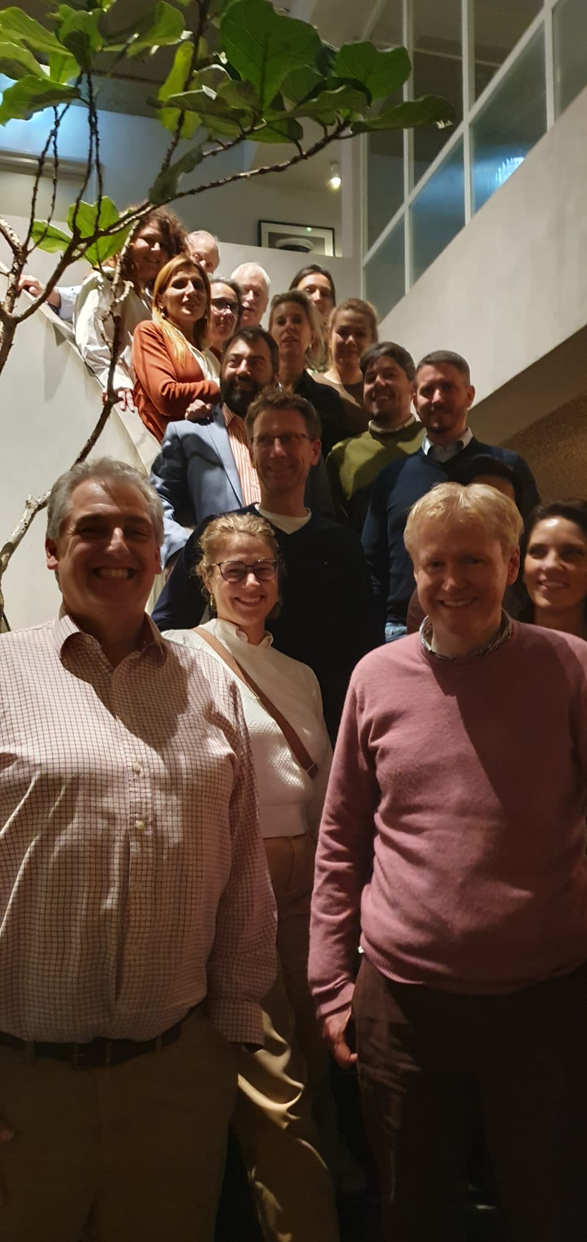
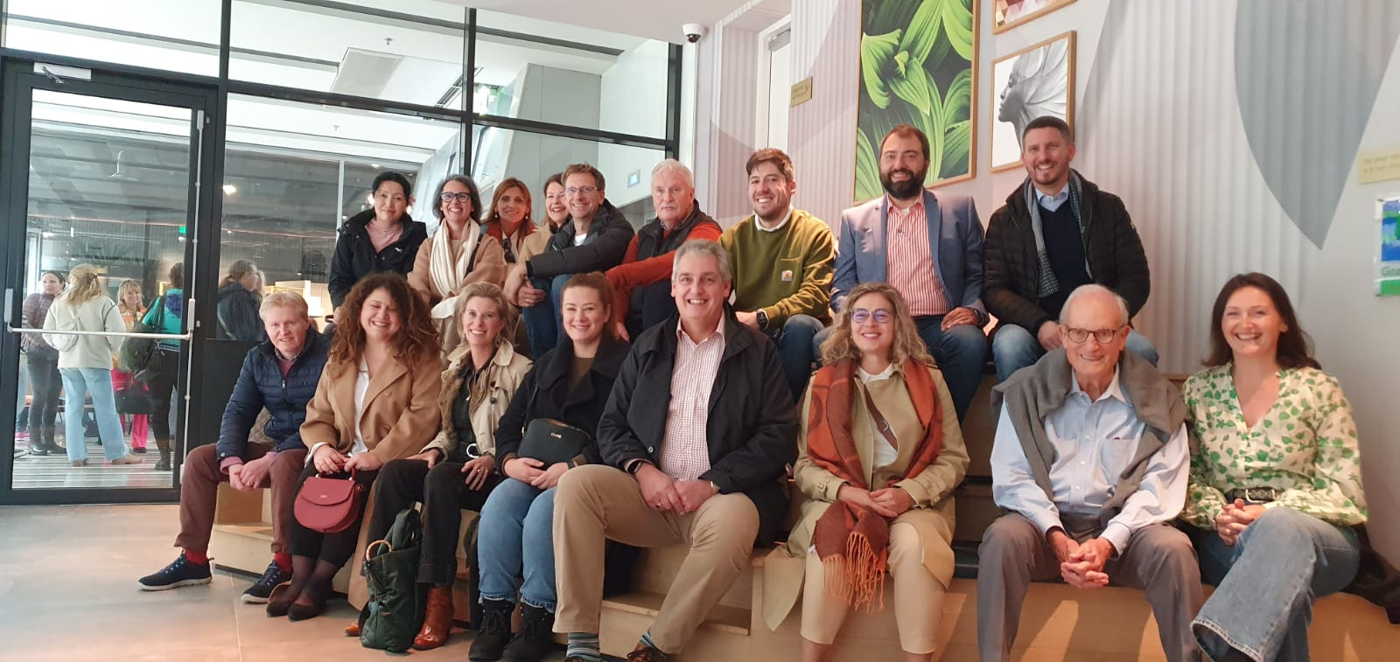
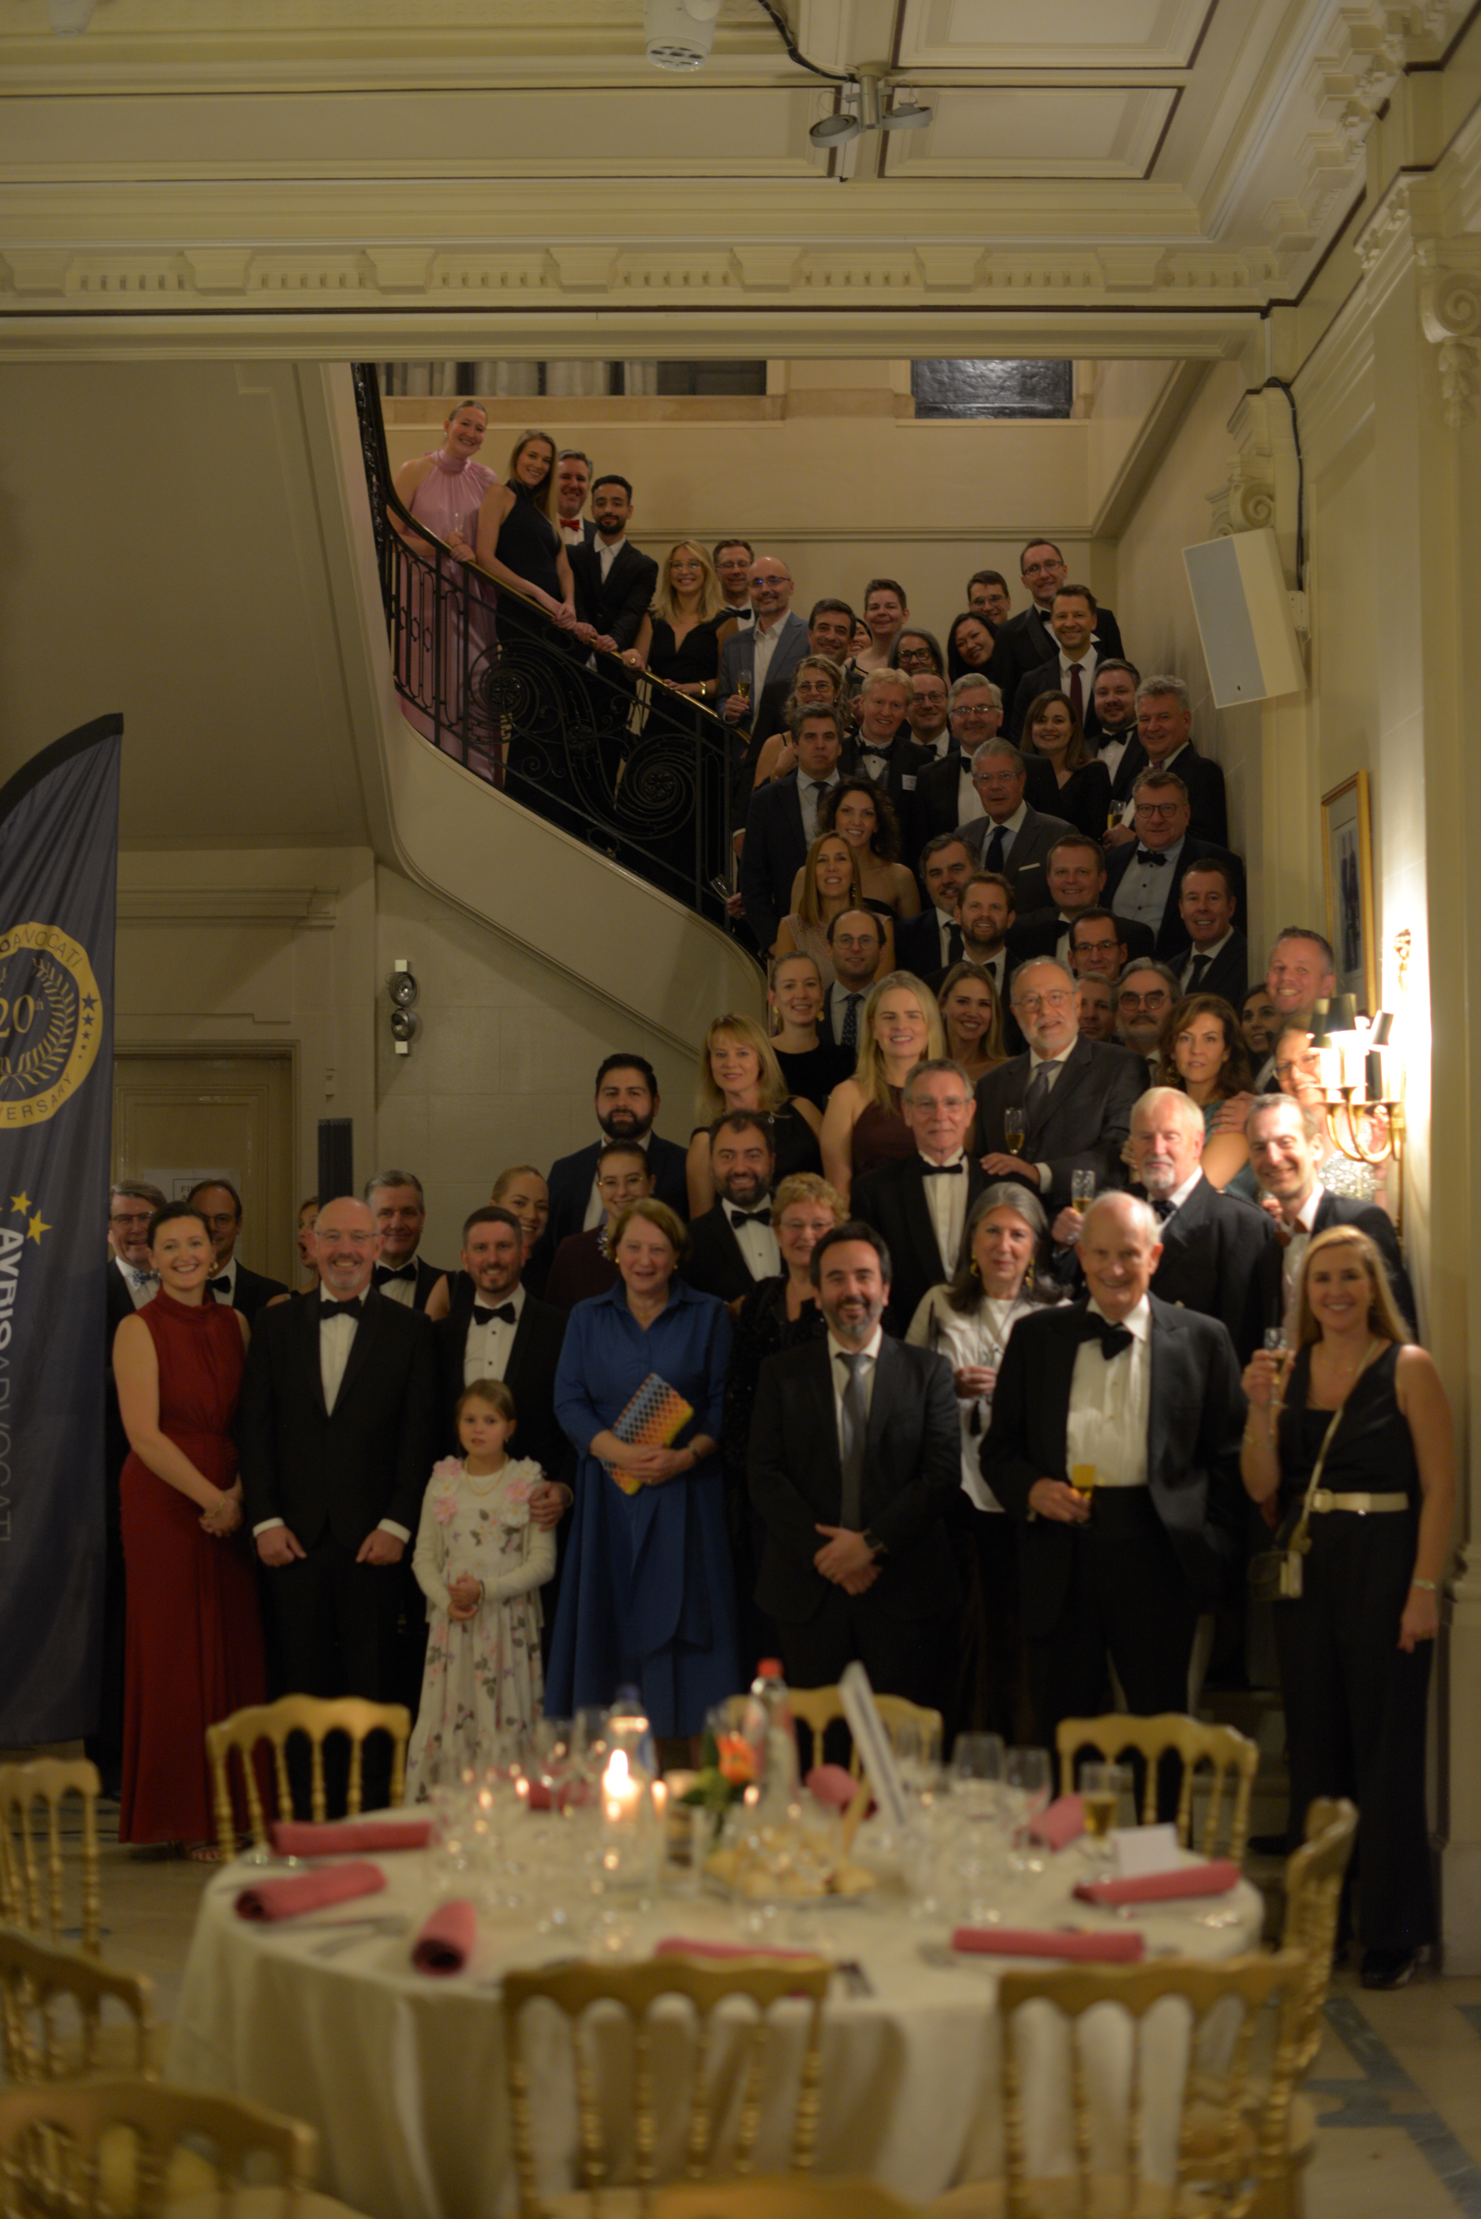
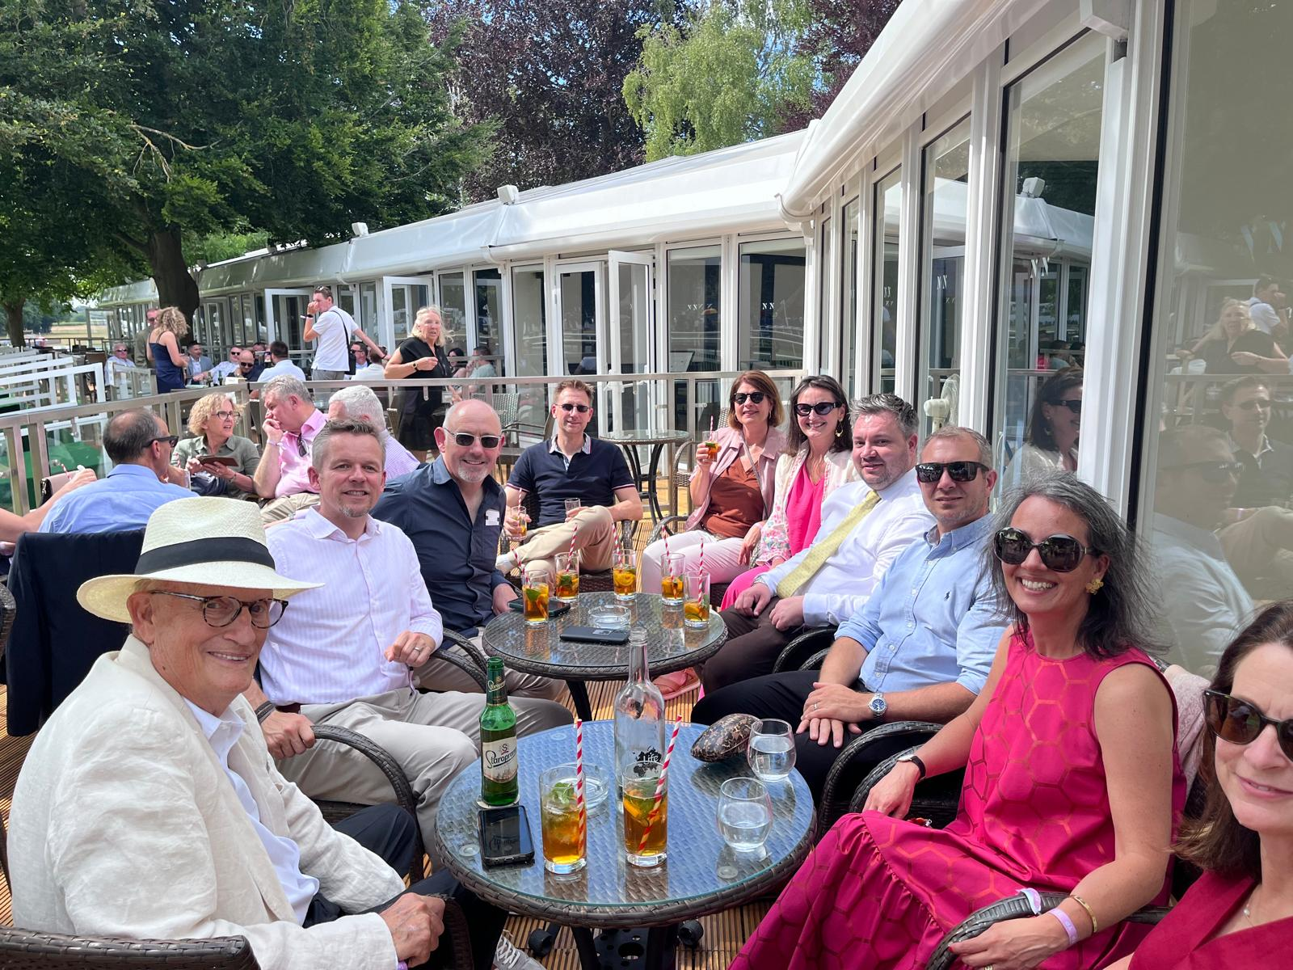
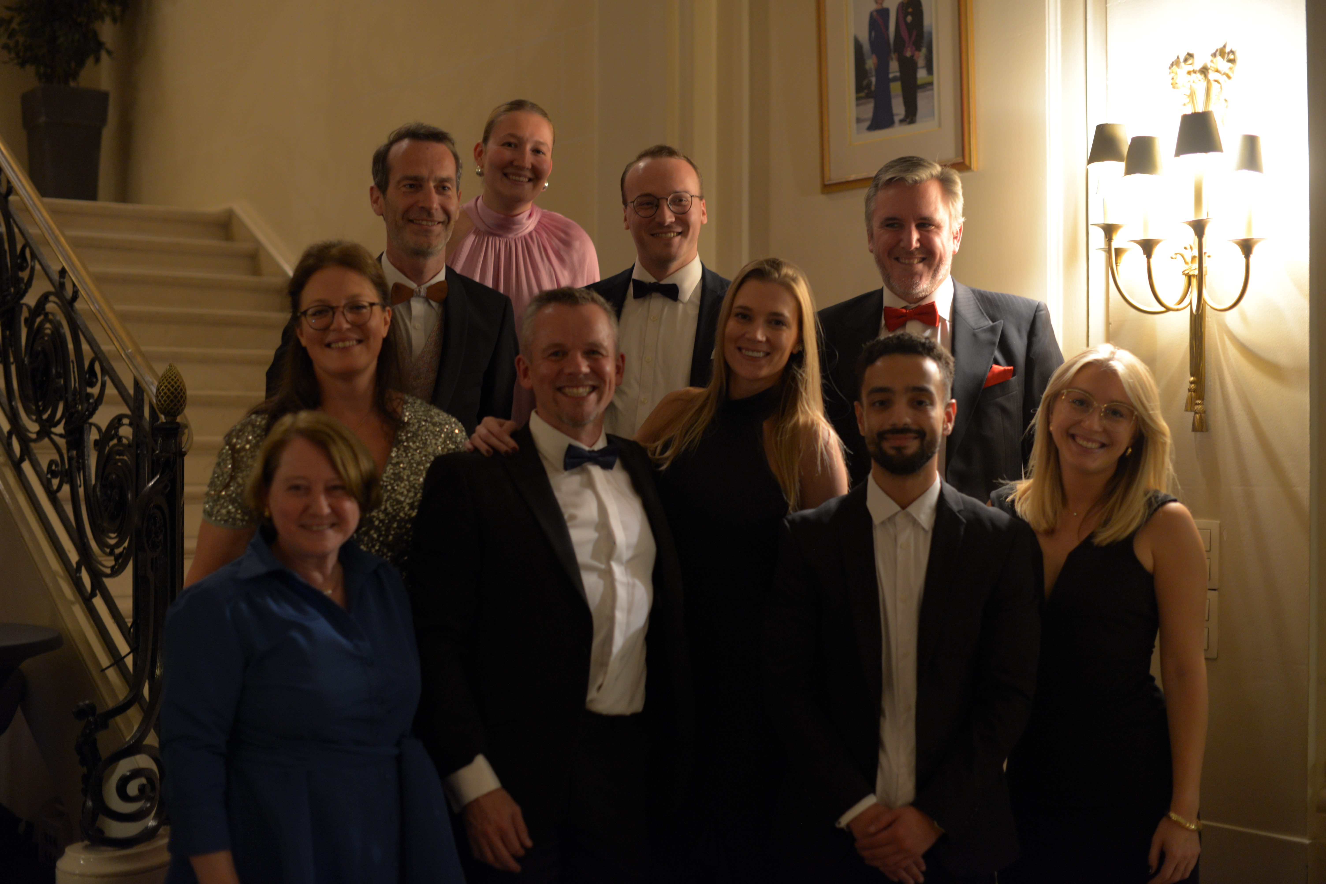
MEET
AVRIO ADVOCATI
MEET
Become a Member

Slide 3


01
Avrio was founded in 1986, and became Avrio Advocati in 2000
02
To create a strong alliance of independent legal professionals
About Us
03
Developed into a network spanning multiple continents
04
Committed to cross-border collaboration and legal expertise
05
Knowledge share and best practice
Become a Member

Slide 4


International
Members are located in 31 countries* and over 80 offices /cities around the world
Legal Experts
Hundreds of lawyers working together to support international clients
Collaboration
About
Our
Members
Committed to excellence in cross-border collaboration and legal expertise
Legal Areas
Specialists in corporate law, dispute resolution, IP, employment law, real estate, finance, family and more
Become a Member
*Jurisdictions like France and Germany have multiple firms in the same country

Slide 5



Member Locations
Europe, US, Canada, Asia, and Africa
Become a Member

Slide 6


Member Benefits
QUALITY
PEOPLE
Specialist legal expertise
High quality work referrals
Culture of warmth and integrity
Q
P
Trusted network of highly skilled peers
Innovative and ambitious team
Peer learning
I
O
OPPORTUNITIES
INTERNATIONAL
Legal support globally
Trends and their impact on legal services on an international scale
Grow your firm and support clients better
Receive referrals
Take part in the Lawyer Exchange Programme
Become a Member
An International Network of Law Firms

Slide 7

Conferences & Networking
2 international conferences each year
8 specialist working groups - meet online monthly / quarterly
Webinars on emerging legal trends and international regulations
Become a Member

Slide 8
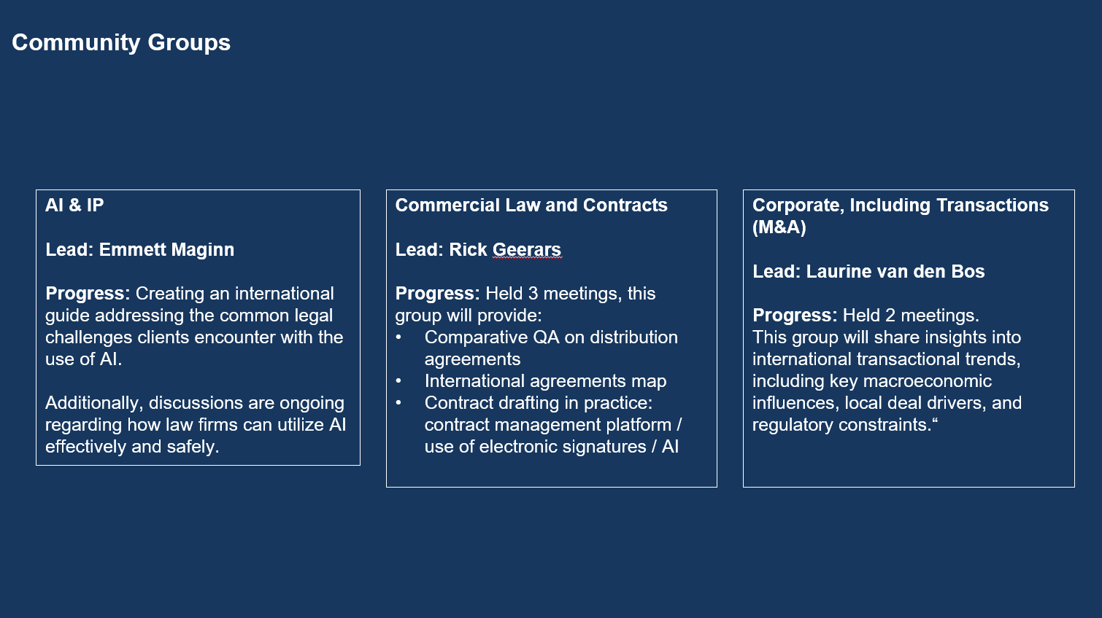

Slide 9
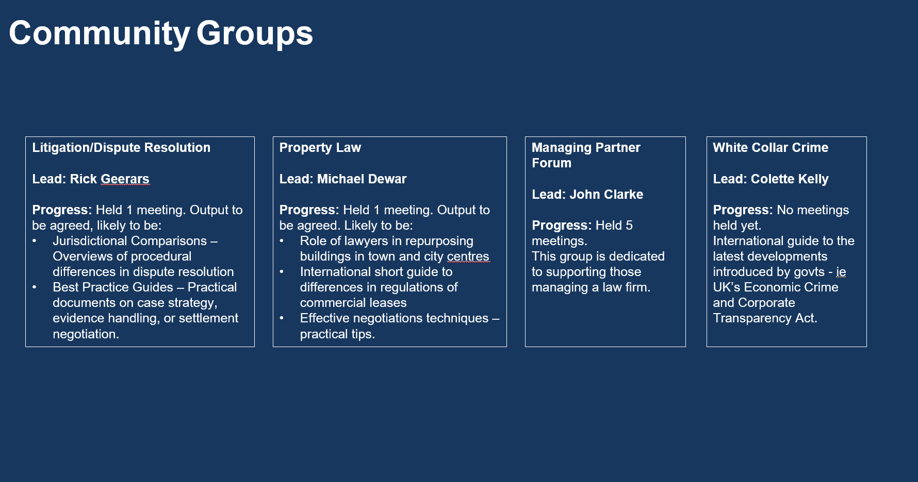

Slide 10

We are growing
The Avrio Advocati Expansion Committee is on the look out for suitable law firms to join our network » Connect. Learn. Grow.
Become a Member

Slide 11
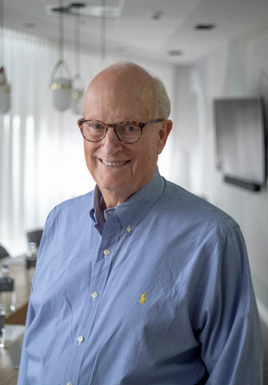

Avrio Advocati President
Avrio is an extensive network of international, collaborative firms that share knowledge and work in concert to serve the needs of clients worldwide.
About Avrio Advocati
Bruce
Bowden
LEECH TISHMAN
Become a Member

Slide 12
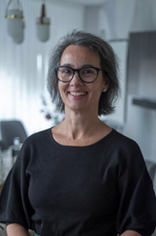
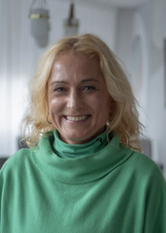

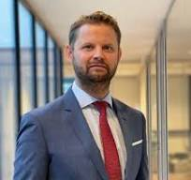

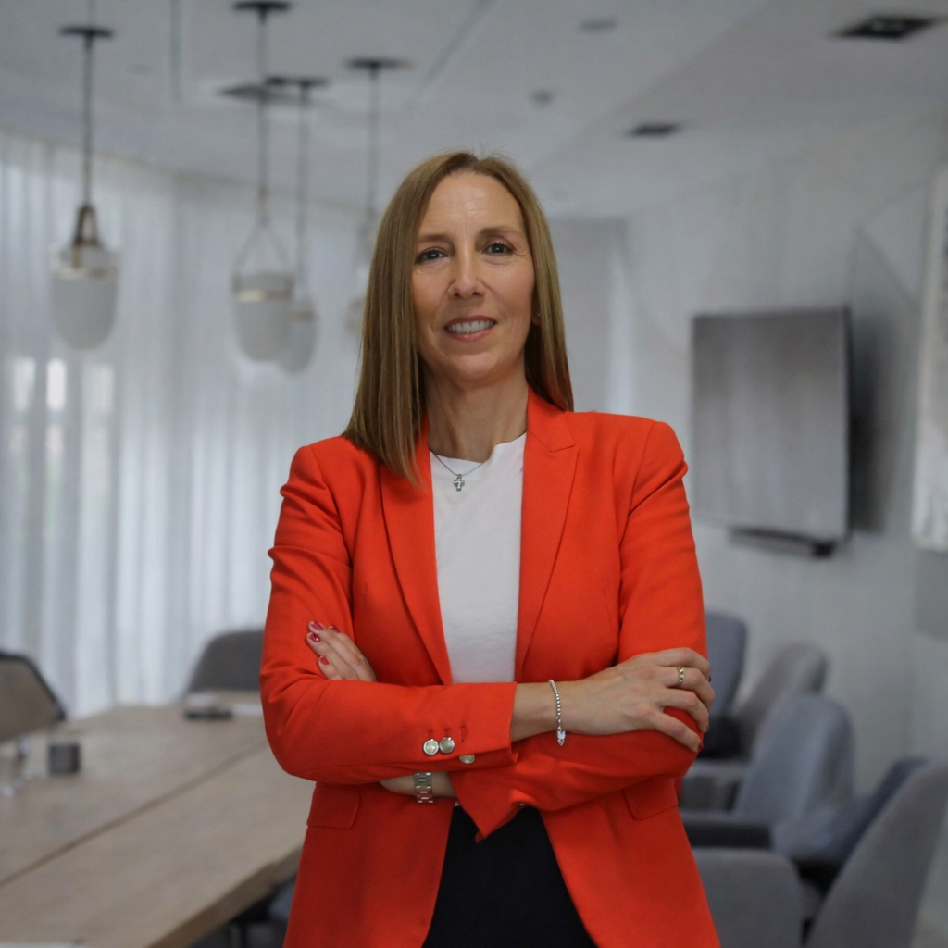
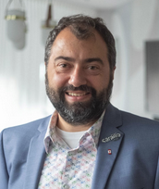
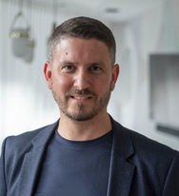
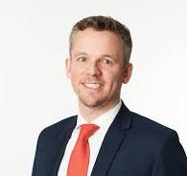
Board Members
Ana RitaRelógio
Rick Geerars
HÖCKER
Vesna Gorjup
Bryan Bletso
CSA
GORUP LAW
IRWIN MITCHELL
Bruce Bowden
LEECH TISHMAN
Cristina Abilleira
Christian Sarailis
Benoît Morzier
Guy Rulkin
Become a Member
EJASO
SARAILIS AVOCATS
AVOPARTNER
ebl Redsky

Slide 13




Contact Us
@avrioadvocati
info@avrioadvocati.com
www.avrioadvocati.com
Become a Member

Slide 14

THANK YOU
Contact Us
Become a Member

