Slide 1
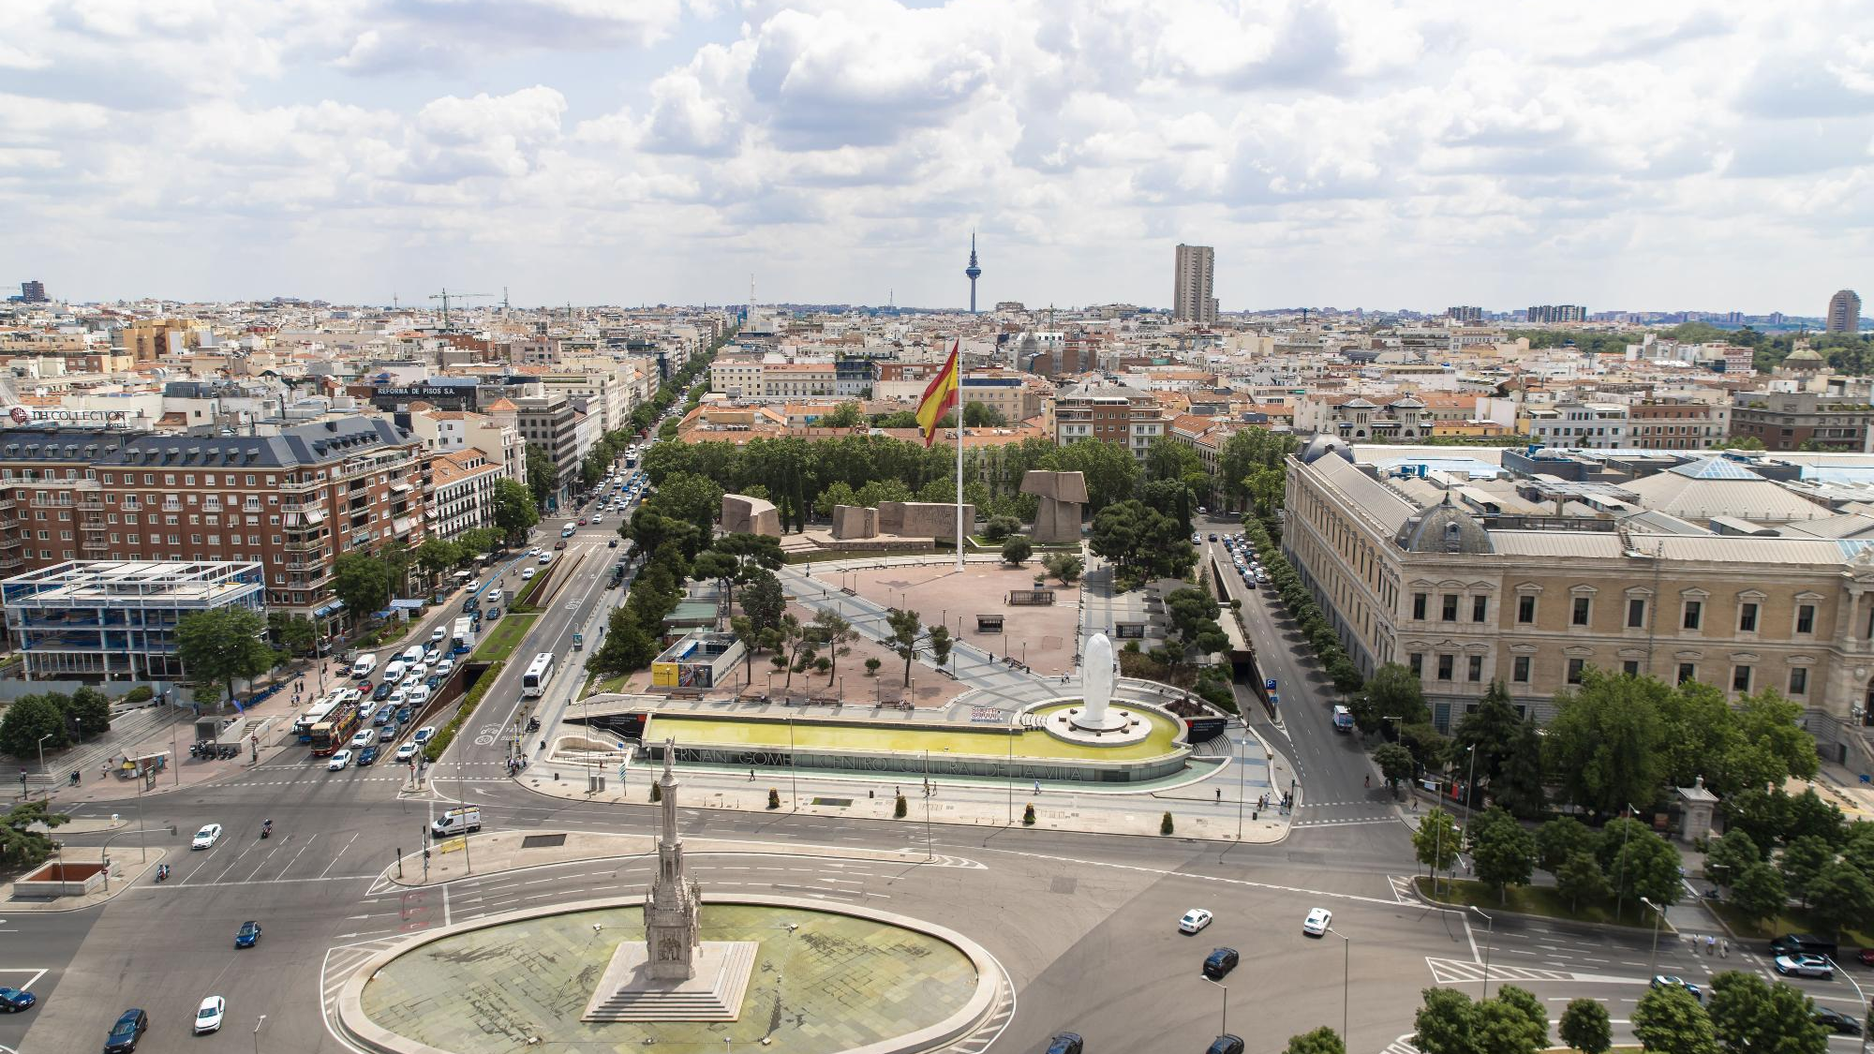



AUTUMN CONFERENCE

Slide 2


CONFERENCE DATES
The Avrio Advocati Autumn Conference will take place from 12 to 14 November 2026 in Madrid, offering an ideal setting for both professional exchange and networking.
Over the course of three days, attendees will have the opportunity to participate in discussions, and connect with peers in a dynamic and internationally oriented legal hub.
Madrid’s accessibility and vibrant professional environment make it a fitting location to host a forward-looking event of this nature.

Slide 3
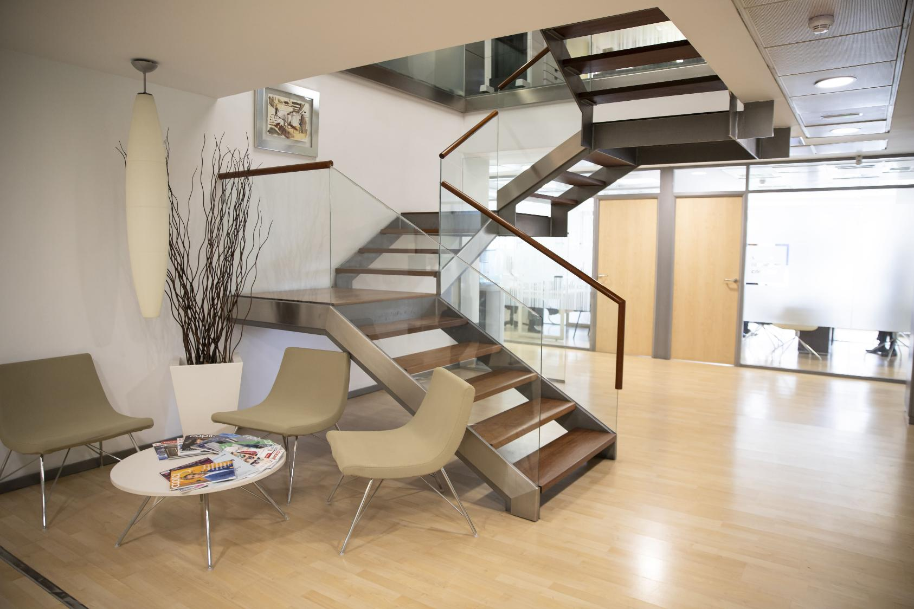

CONFERENCE THEME
We aim to explore the evolving landscape of the legal sector, focusing both on emerging areas of practice and the complex challenges reshaping the profession.
Through a series of expert-led talks, attendants will gain insights into new and rapidly developing sectors, while also examining the regulatory, technological, and societal shifts that are redefining the role of lawyers.
The programme aims to foster forward-looking discussion, equipping attendees with a deeper understanding of how to navigate change and seize new opportunities within an increasingly dynamic legal environment.

Slide 4



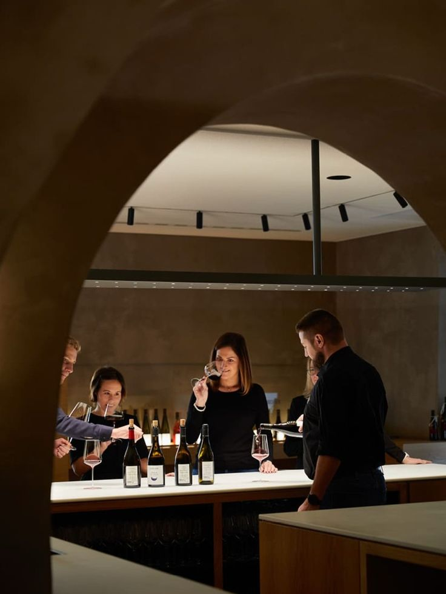

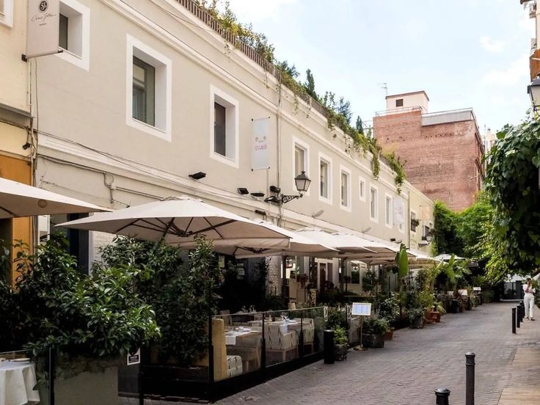
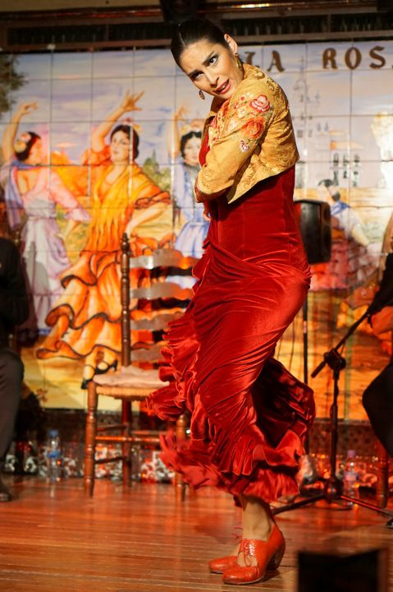
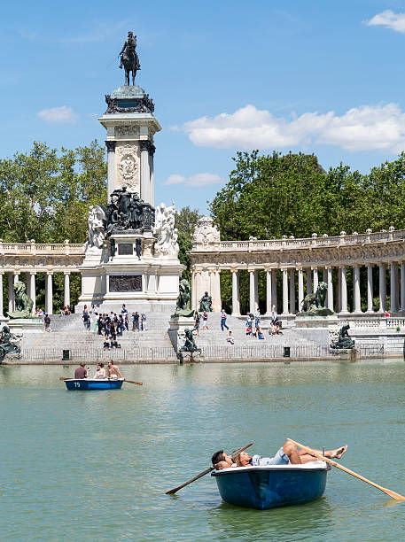
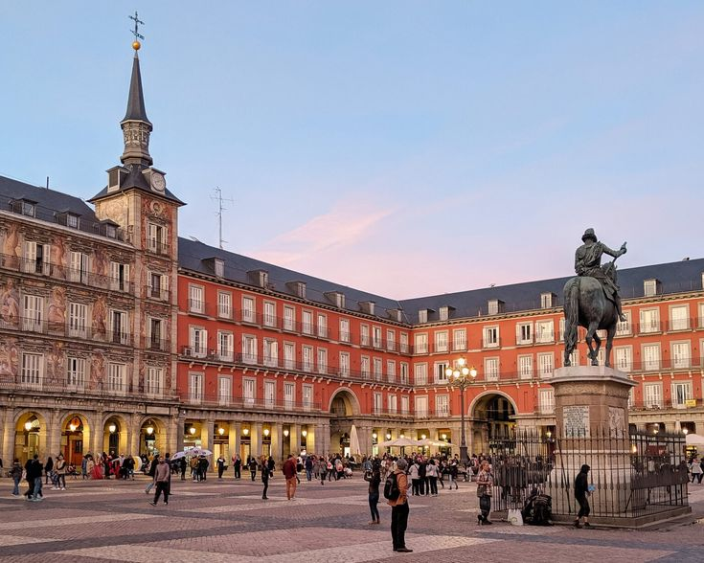
SOCIAL ACTIVITIES IN MADRID
Alongside the sessions and panels, the conference will feature a curated selection of social activities designed to encourage informal interaction and strengthen professional relationships.
These will include group dinners, and cultural beyond the conference sessions. experiences that showcase the character of Madrid, providing attendees with a relaxed environment to build connections

Slide 5


Slide 6


Slide 7



